Slide 1




Slide 2

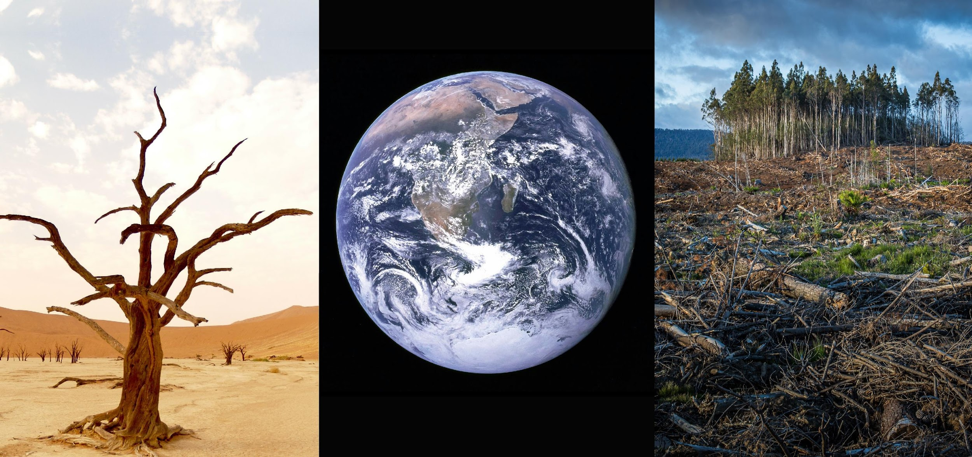

Slide 3

Swedish centre for impacts of climate extremes | www.climes.se

Slide 4
Swedish centre for impacts of climate extremes | www.climes.se

Slide 5
Swedish centre for impacts of climate extremes | www.climes.se

Slide 6
Swedish centre for impacts of climate extremes | www.climes.se

